Slide 1
Zulfiqar Ali Bhutto Regime (1971-1977)

Slide 2
Civilian Marital Law administrator
On 16 December, 1971 Yahya khan admitted defeat in East Pakistan.
Mrs. Gandhi, under pressure of USA, announced unilateral ceasefire on 17 December, 1971.
After fall of Dhaka and the emergence of Bangladesh, there was no justification for Yahya Khan to continue in power.
The military colleagues of Yahya khan asked Yahya khan to hand over power to Bhutto.
Z.A Bhutto’s PPPP had won majority seats in the West Pakistan.

Slide 3
Land Reforms 1972
Bhutto revised the land reforms introduced by Ayub Khan
Whereas the ceiling for the irrigated land was 500 acres and unirrigated was 1000 acres during Ayub Khan era, Bhutto changed it in to 150 acres and 300 acres respectively.
However, the transfer of lands before 20 December 1971 to wife, sons, daughters, father, mother, and sons were declared valid.
The courts did not have any jurisdiction to challenged the provisions of the land reforms.

Slide 4
Nationalization of industries
On January, 1972 government took over the private industries that included the iron and steel foundries, metal, engineering, heavy electrical, motor vehicles assembly, cement, chemical, etc.
Economic reform order was issues in 1972.
No courts including supreme court or the high court could challenge any provision of the nationalization of the industries.
The managing directors of the industries were appointed from the bureaucrats who lacked the experience of managing the industries.
The raw material disappeared from the industries

Slide 5
Nationalization of schools
Another reform introduced under which the management of the , private schools and colleges were taken over by government on April 1972.
The regulation did a lot of damage to the educational set up in the country.
The reputation of high-quality education and maintaining high standards was ruined.

Slide 6
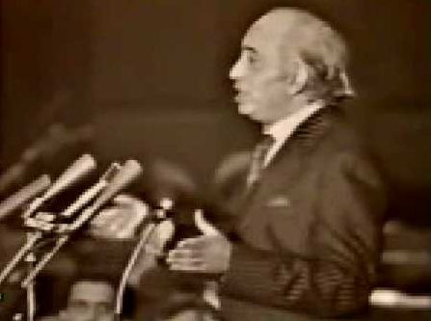
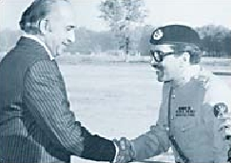
On 17th April 1972 an interim Constitution was adopted by NA which provided Presidential form of Govt.
The assembly formed a Constitution Committee on 17th April 1972 to prepare the draft for new Constitution

Slide 7
Interim Constitution 1972
Presidential form of government was retained as it was in 1962 constitution.
The President was the head of state as well as the head of government.
The unicameral system was maintained as it was during 1962 constitution.
The distribution of power between center and government was also similar to 1962 constitution.

Slide 8
Simla Agreement
Peace negotiations between Pakistan and India since the creation of Bangladesh started in April, 1972.
Initial talks were held in Muree between Pakistan and India in which emissaries from both India and Pakistan participated. In this talks meeting was decided to be held between Bhutto and Indira Gandhi in June of 1972.
The summit conference between Bhutto and Indira Gandhi held in June 1972 in Simla.
A peace agreement was decided by both the leaders in July 1972.

Slide 9
Major points
Line of control resulting from the ceasefire of 17 December, 1971 shall be respected by both sides.
The Indians troops shall be withdrawn from the Pakistani territory from Punjab and Sindh occupied during the war.
The Pakistani troops shall be withdrawn from Indian territory Indian territory of Punjab and Rajhistan.
In Kashmir, India will retain the territories 480 square miles west and north of former ceasefire line in Poonch, Tithwal, and Kargil.
Pakistan will retain 52 square miles east of the line of control in the Chamb sector

Slide 10
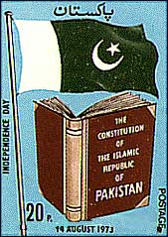
1973 Constitution
1973 Constitution was passed with absolute majority on 10th April 1973 which was promulgated on 14th August 1973 and on same day Z A Bhutto took oath as PM
1973 Constitution provided parliamentary form of Govt with bicameral legislature where as from 1947 to 1973 the country had unicameral legislature

Slide 11
Amendments to constitution
1st amendment
The second Islamic Summit Conference was held in 1974 in Lahore, Pakistan.
The organization of Islamic conference was established to oppose the annexation of Palestinian territories by Israel in 1970.
Bhutto recognized the state of Bangladesh in the second Islamic Conference due to the request made by King Faisal of Saudi Arabia and Qadhafi of Libya
Mujib was not wiling to attend the conference until Bangladesh had not been recognized as separate country by Pakistan.
2nd amendment
Ahmadis were declared as non-Muslims. Article (260) was added to the constitution in which the non-Muslim was defined. It was stated that whosoever does not believe in the finality of the prophet is not a Muslim.

Slide 12
Bhutto and security agencies
Bhutto created Federal Security Force to subdue the political opponents.
The security agencies like army and police did not like the creation of FSF because it was a parallel organization to them.
Bhutto also acted against the military, he dismissed 43 senior military officers who thought to have remained closer to Yahya Khan.
He removed Lt. Gen Gul Hasan Khan, army chief and Air Marshal Rahim Khan, chief of Air staff.

Slide 13
Center and province relations during Bhutto era
NAP and JUI has agreed for the continuation of Martial law and also voted for Bhutto as President in 1972.
In return they were allowed by Bhutto to form ministries in NWFP and Baluchistan.
The Martial law has been used to restrict fundamental rights, judicial authority, and the due process of law.
Under this context the NAP-JUI government announced that the Martial law should be lifted.
Although Bhutto agreed to lift Martial Law, but he started to encourage the rival political parties of NAP-JUI in Baluchistan and NWFP.

Slide 14
When Bhutto returned from Simla, he began accusing the NAP-JUI government in NWFP of seeking confrontation with the central government. They were labelled as traitors, and foreign agents.
NAP-JUI government in Baluchistan demanded to return the non-local public servants in favor of the local people.
In 1972, the Marri Tribes man raided Punjabi settlements in the Pat Feeder area and killed several men.
The Baluchistan student's organization an affiliate of NAP at that time kidnapped federal railway officials in Quetta.
Bhutto used the FSF to subdue the opposition in provinces.
The separation of East Pakistan has encouraged the emergence of Baloch separatist movement.

Slide 15
1977 elections and downfall of Bhutto
The 1977 elections held under the Bhutto regime were opposed by the opposition (Pakistan National Alliance) to have been rigged.
The PNA gathered public support against Bhutto and demanded to implement the Nizam-e-Mustafa.
The opposition was supported by the armed forces.
Zia-ul-Haq who was appointed by Bhutto as army chief of Pakistan prevented the opposition from reaching a consensus with Bhutto.
In this manner when the conditions of the country worsened. Zia-ul-Haq imposed Martial law in the country.

